Slide 1


Slide 2




Slide 3










Slide 4



Slide 5





Slide 6





Slide 7





Slide 8










Slide 9










Slide 12




Slide 13






Slide 14




Slide 15






Slide 16





Slide 17



Slide 18


Slide 19



Slide 20




Slide 21



Slide 22



Slide 23





Slide 24





Slide 25


Slide 26
Queries and Relationship Direction
For UniDirectional Relationships, a query can navigate from say, LineItem to Product but cannot navigate in the opposite direction.
Relationship Direction has no impact on your database mapping, but it defines in which direction you can use the relationship in your domain model and JPQL or Criteria queries.
For BiDirectional Relationships, a query can navigate from say, Order and LineItem, a query could navigate in both directions because these two entities have a bidirectional relationship.

Slide 27
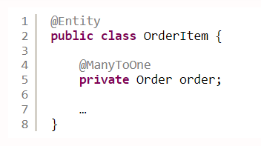
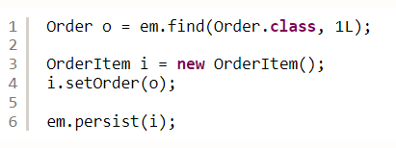
Example Scenario of Queries and Relationship Direction in a Unidirectional Many-to-One Association

Slide 28
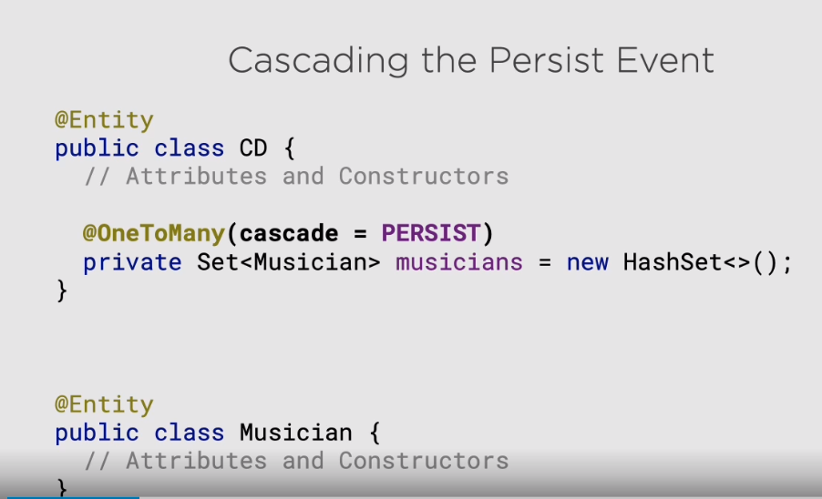

Slide 29


Slide 30


Slide 31
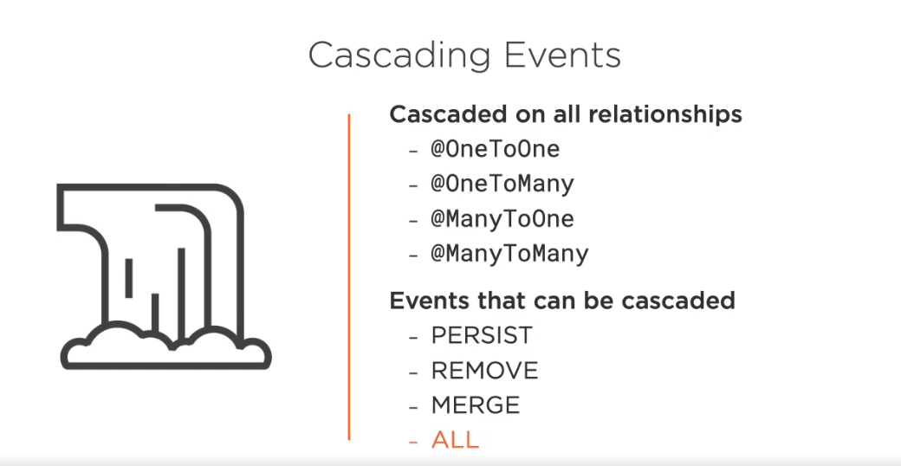

Slide 32


